Slide 1
AI TOOL ANALYSIS DASHBOARD
TECH STACK
SQL
POWER - BI
PYTHON
DATA CLEANING
SOLUTION THROUGH KPIs
Insights from the data
Data Cleaning
Data Modelling
DAX for Insights
Visualization
NumPy and Pandas
Linear Regression for Predictive Analysis

Slide 2
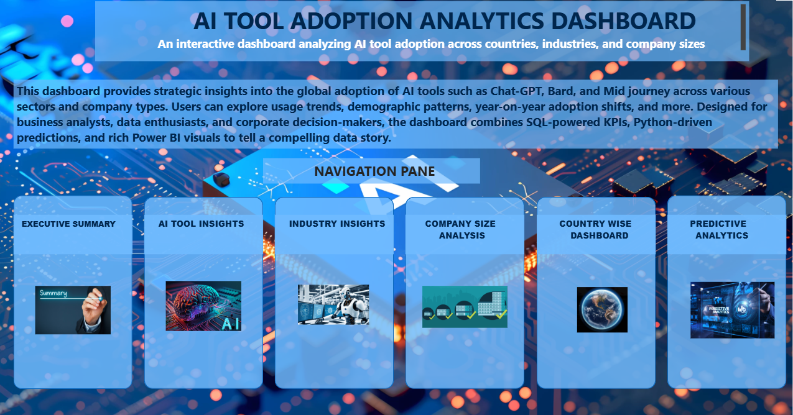
INDEX

Slide 3
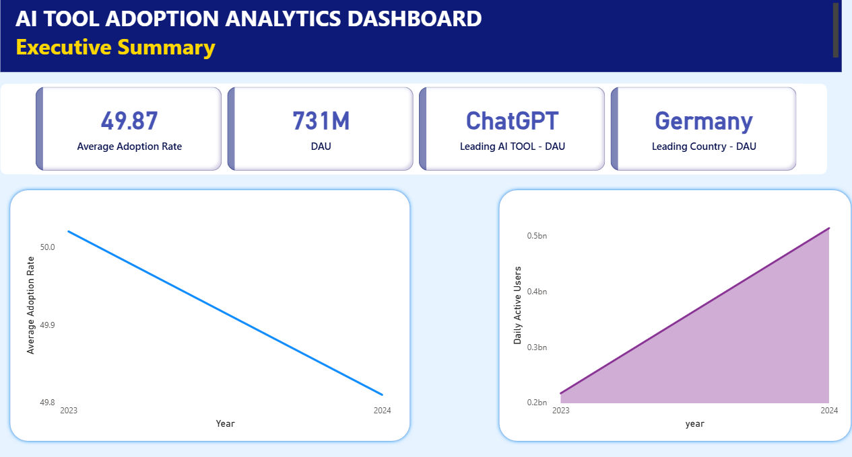
PAGE - 1

Slide 4
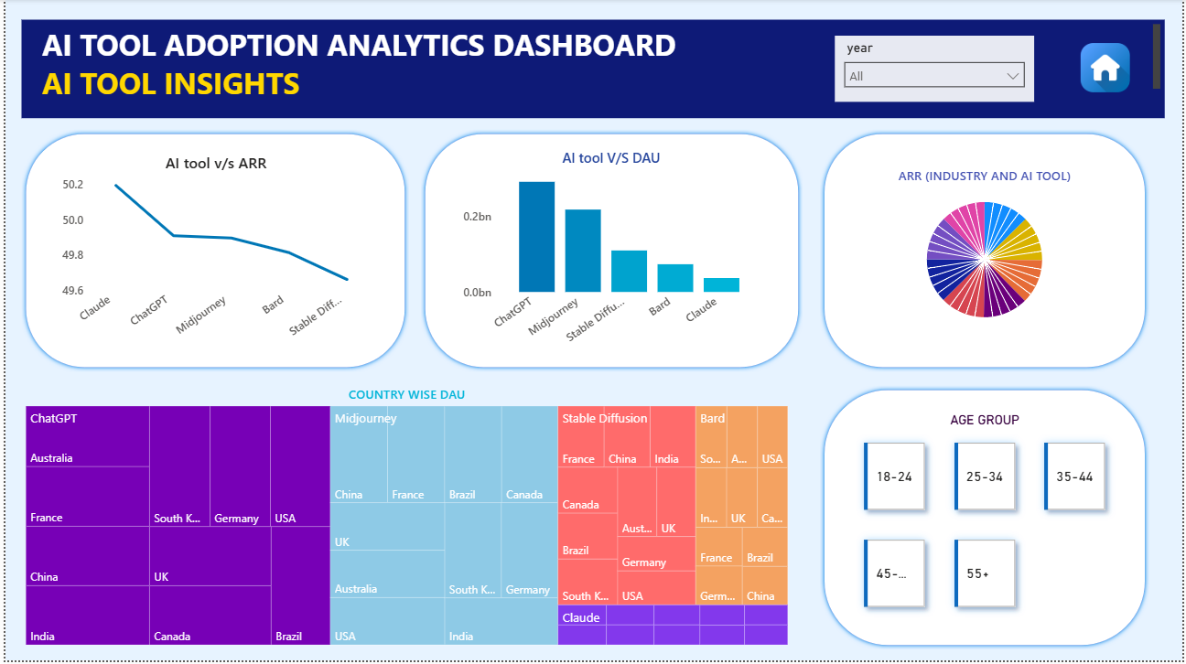
PAGE - 2

Slide 5
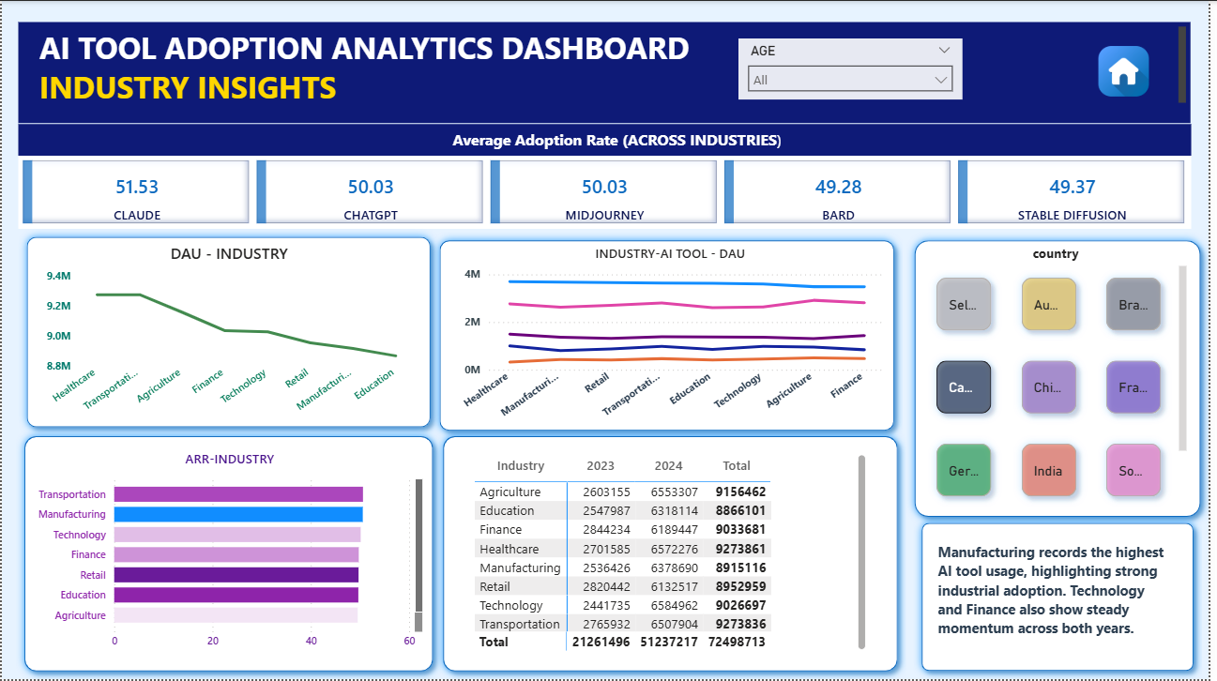
PAGE - 3

Slide 6
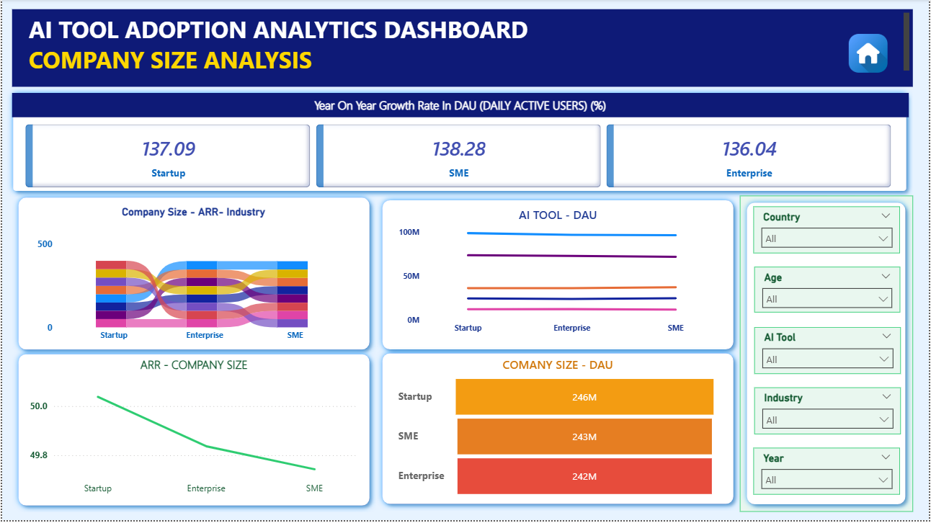
PAGE - 4

Slide 7
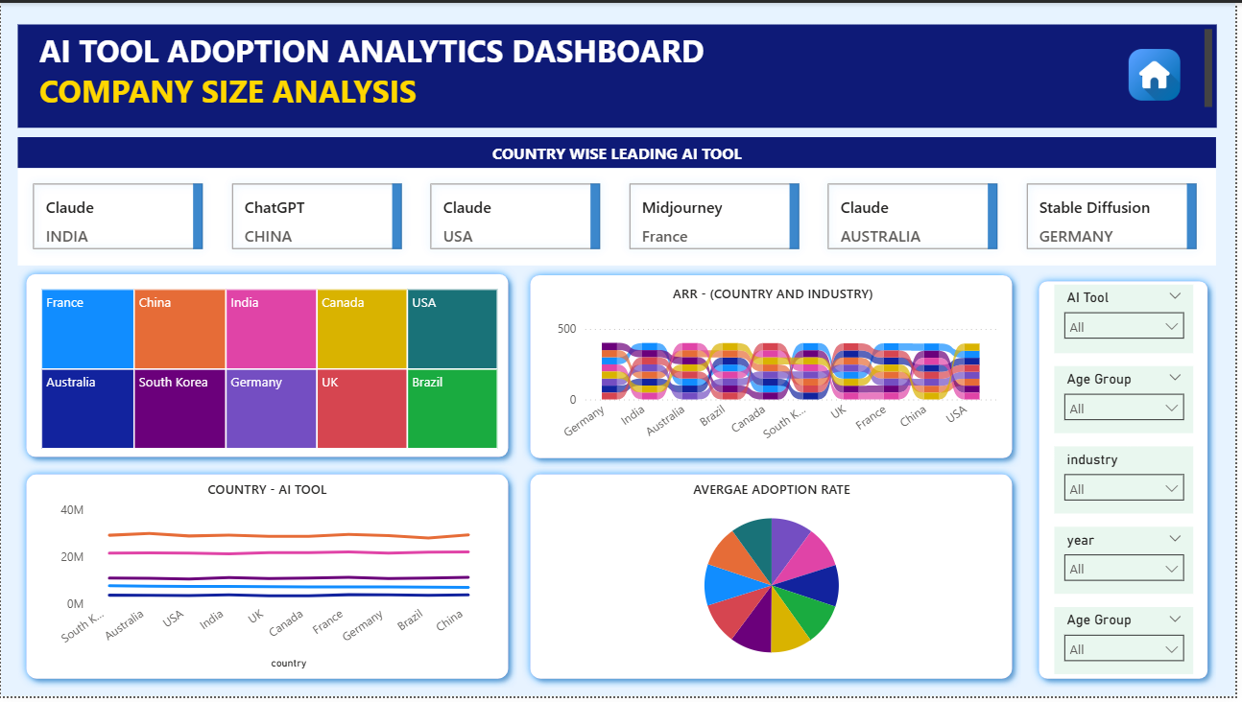
PAGE - 5

Slide 8
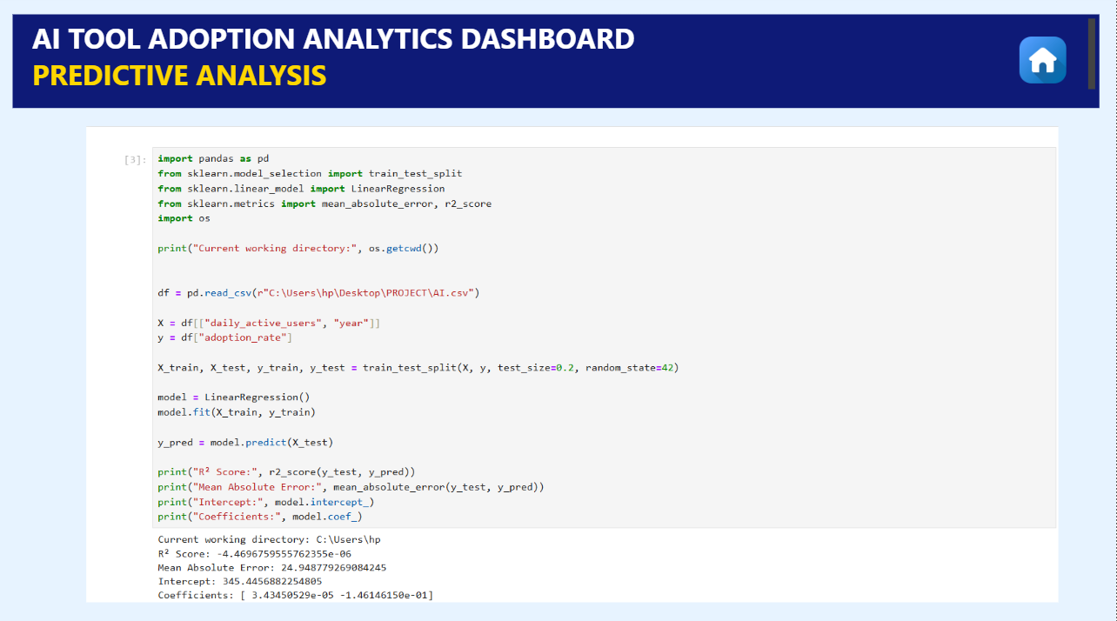
PAGE - 6

Slide 9
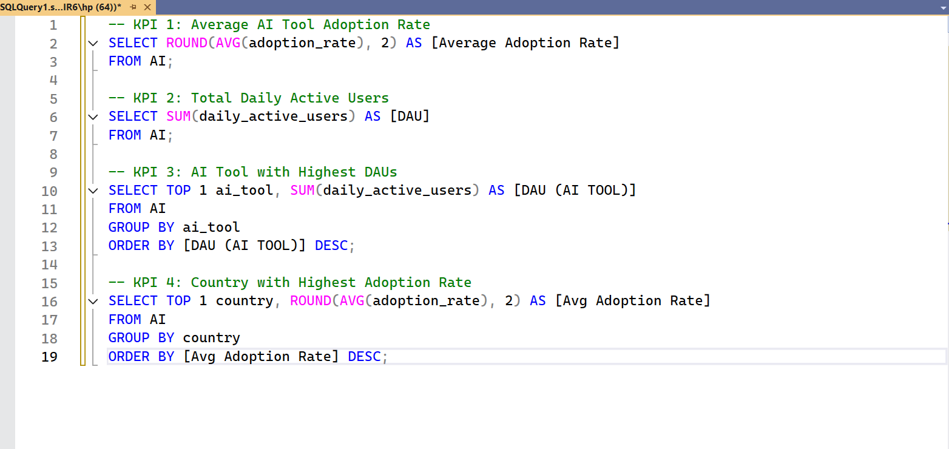
SQL CODE
PAGE - 1

Slide 10
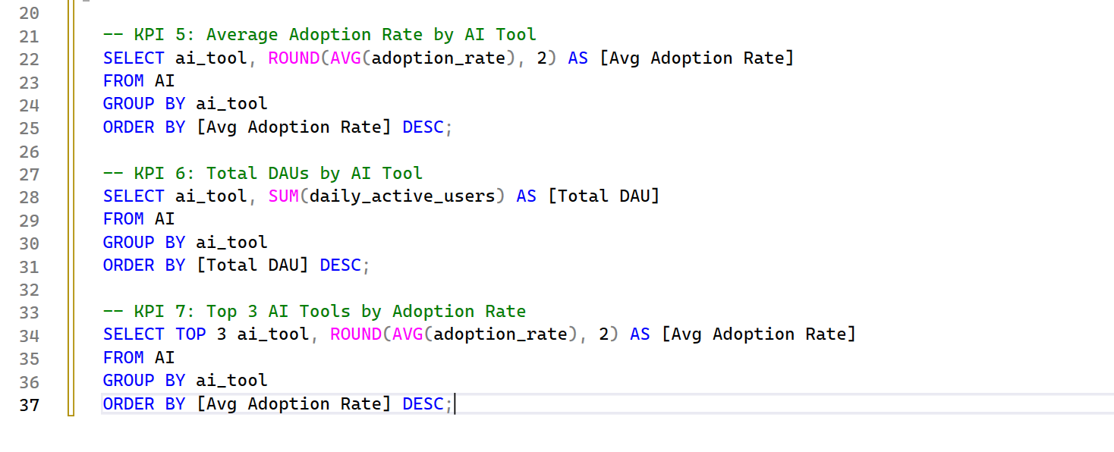
SQL CODE
PAGE - 2

Slide 11
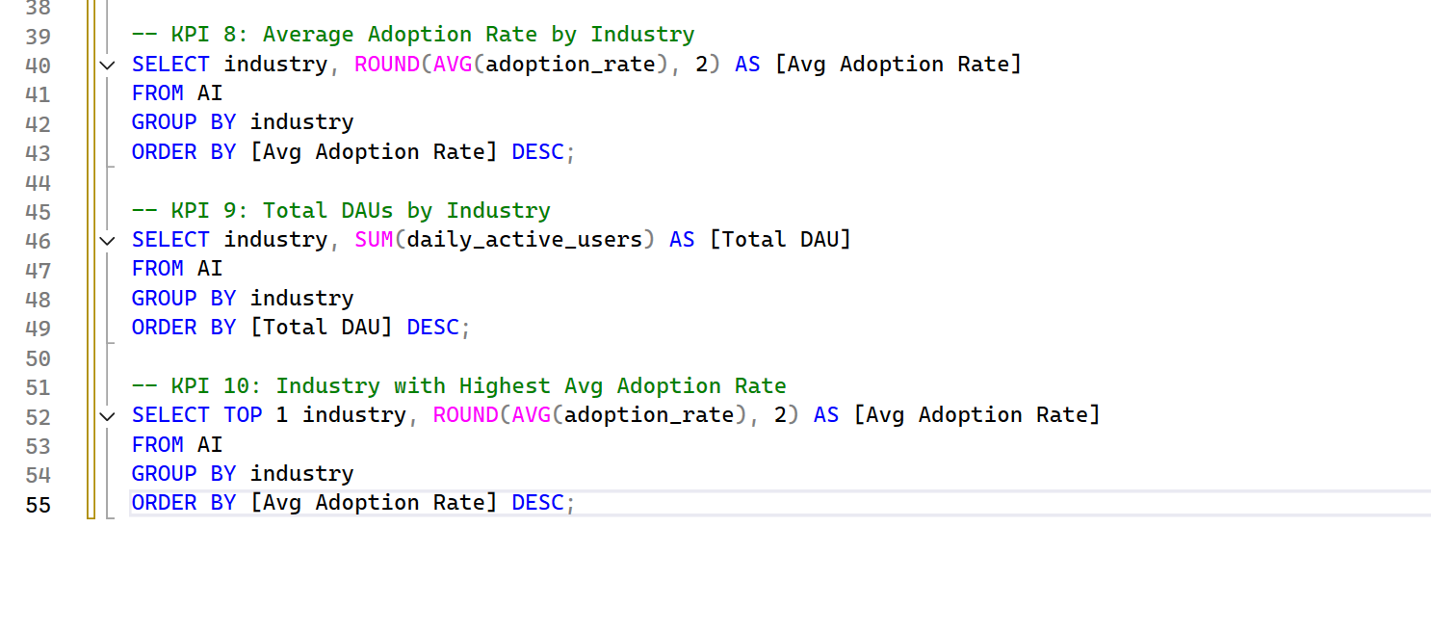
SQL CODE
PAGE - 3

Slide 12
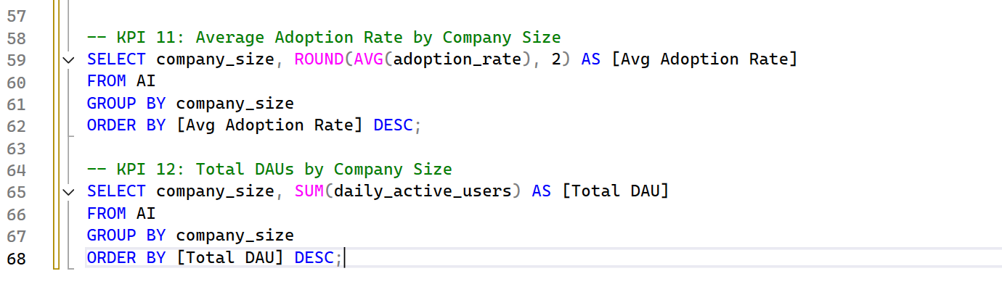
SQL CODE
PAGE - 4

Slide 13
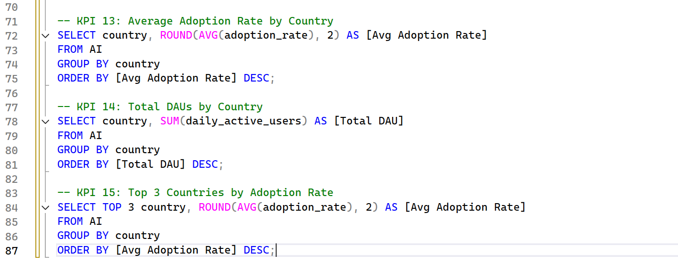
SQL CODE
PAGE - 5

Slide 14
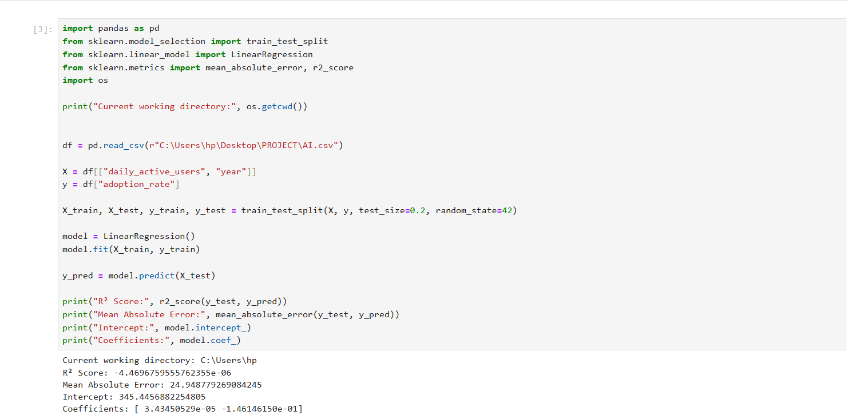
LINEAR REGRESSION

